Slide 1
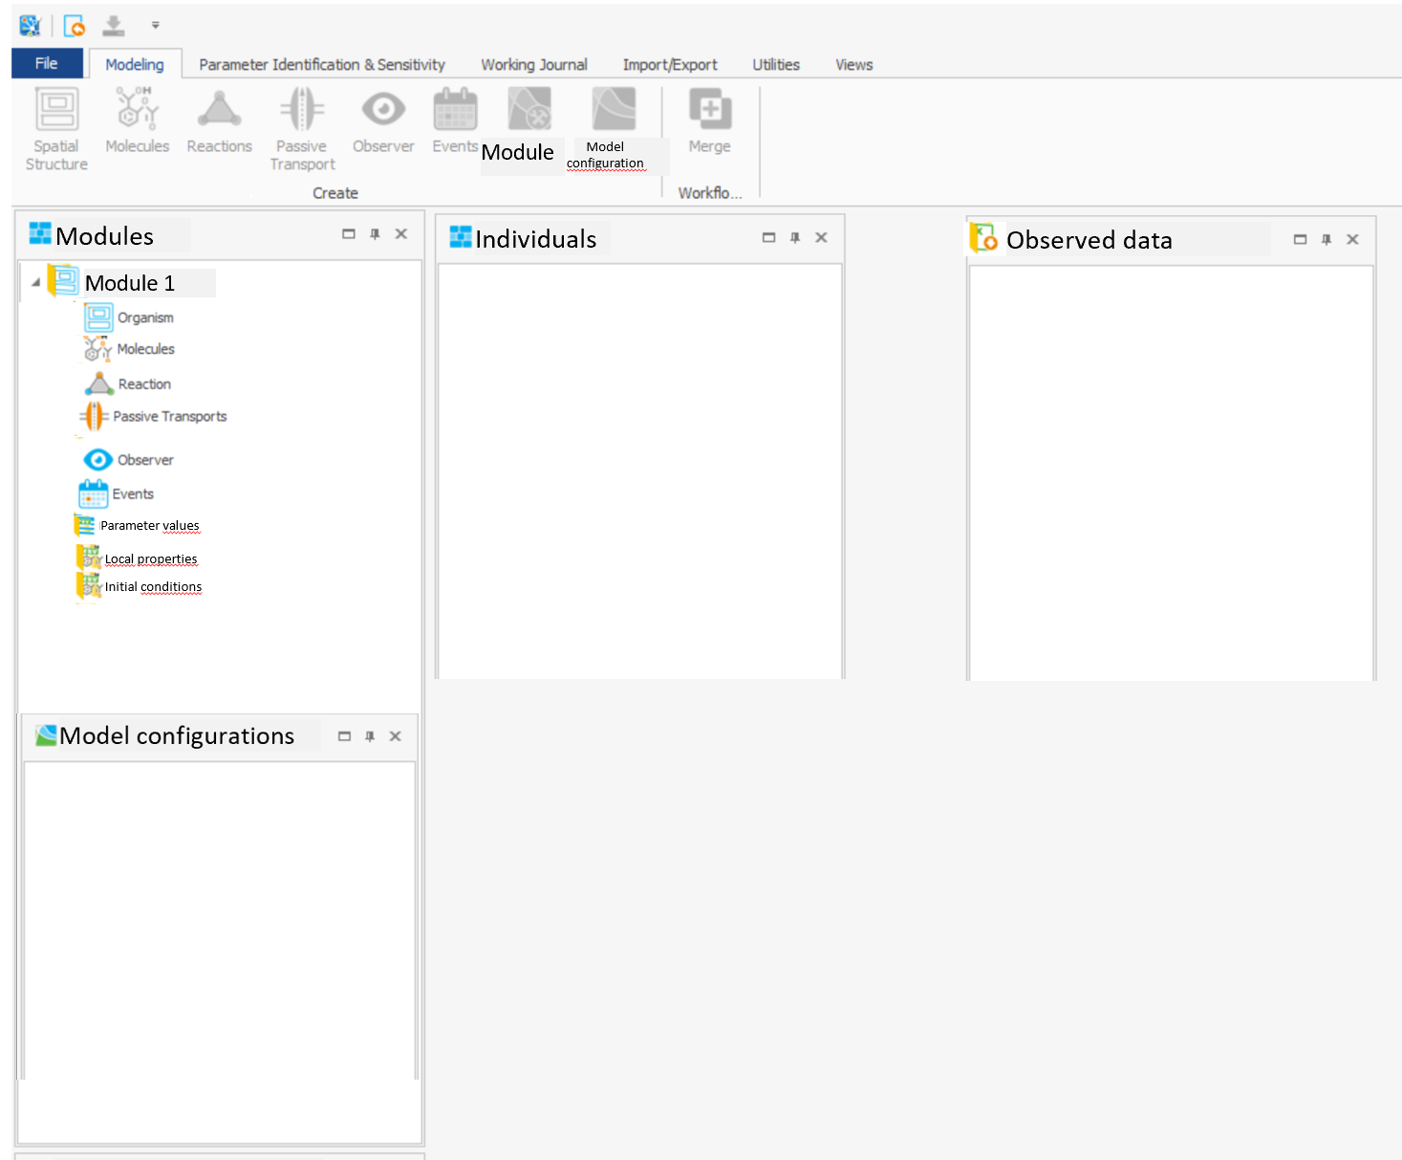
Modularization Concept
User Interface Draft

Slide 2
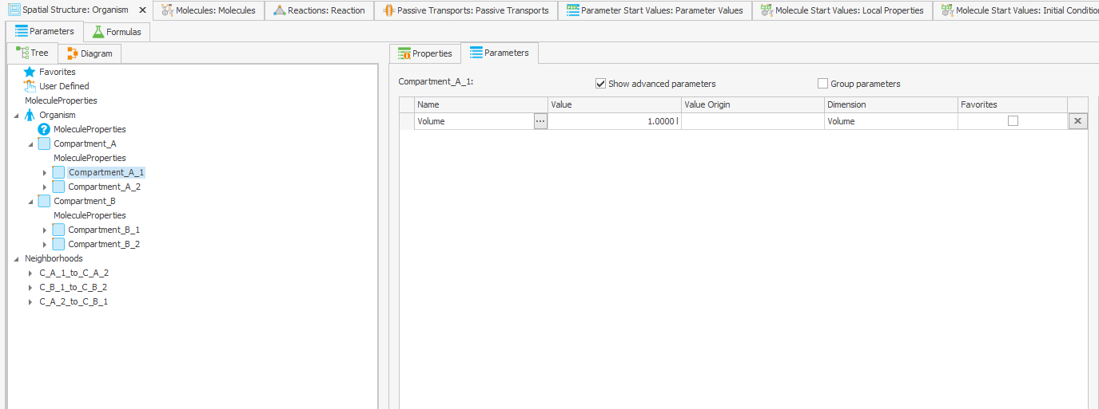
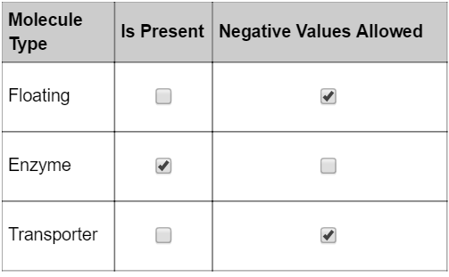
Extension Module 1
Kidney - generic population of „isPresent“ properties
Spatial Structure-BB
Default molecule behavior

Slide 3
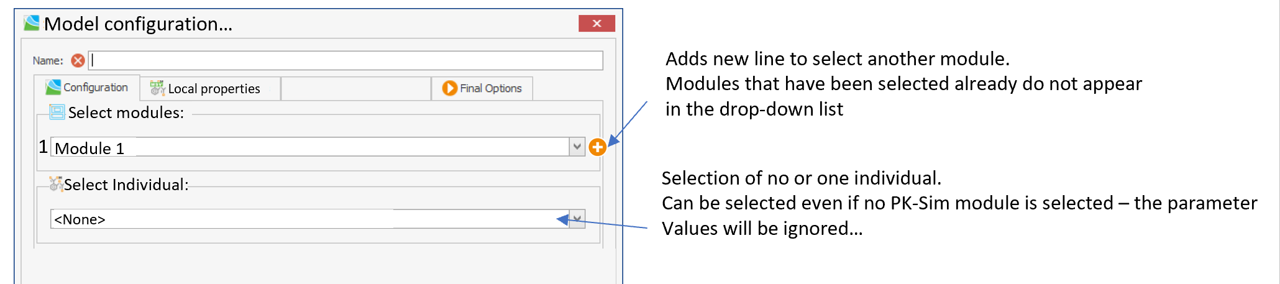
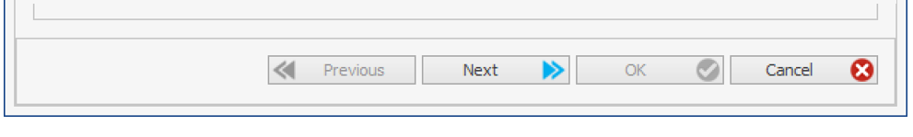
Modularization Concept
User Interface Draft

Slide 4
Module1
SS BB:
Comp1
Comp2
Comp3
Molecules BB:
Mol1
Mol2
Mol3
IC:
-M1Mol1:M1Comp1
-M1Mol1:M1Comp2
-M1Mol1:M1Comp3
-M1Mol2:M1Comp1
-M1Mol2:M1Comp2
-M1Mol2:M1Comp3
-M1Mol3:M1Comp1
-M1Mol3:M1Comp2
-M1Mol3:M1Comp3
-M1Mol1:M3Comp1
-M1Mol2:M3Comp1
-M1Mol3:M3Comp1
-M1Mol1:M3Comp1
-M1Mol2:M3Comp1
-M1Mol3:M3Comp1
-M1Mol1:M4Comp1
-M1Mol2:M4Comp1
-M1Mol3:M4Comp1
Module 2 – Glucose „healthy“
SS BB:
-
Molecules BB:
Mol1
IC:
-M2Mol1:M1Comp1
-M2Mol1:M1Comp2
-M2Mol1:M1Comp3
-M2Mol1:M3Comp1
-M2Mol1:M4Comp1
Module 2 – Glucose „diabetes“
SS BB:
-
Molecules BB:
-
IC:
-M2Mol1:M1Comp1
-M2Mol1:M1Comp2
-M2Mol1:M1Comp3
-M2Mol1:M3Comp1
-M2Mol1:M4Comp1
IS THIS ALLOWED?
HOW TO GET THIS BB?
Module 3
SS BB:
Comp1
Molecules BB:
-
IC:
Module 4
SS BB:
Comp1
Molecules BB:
Mol1
IC:
-M4Mol1:M1Comp1
-M4Mol1:M1Comp2
-M4Mol1:M1Comp3
-M4Mol1:M3Comp1
-M4Mol1:M4Comp1

